Slide 1
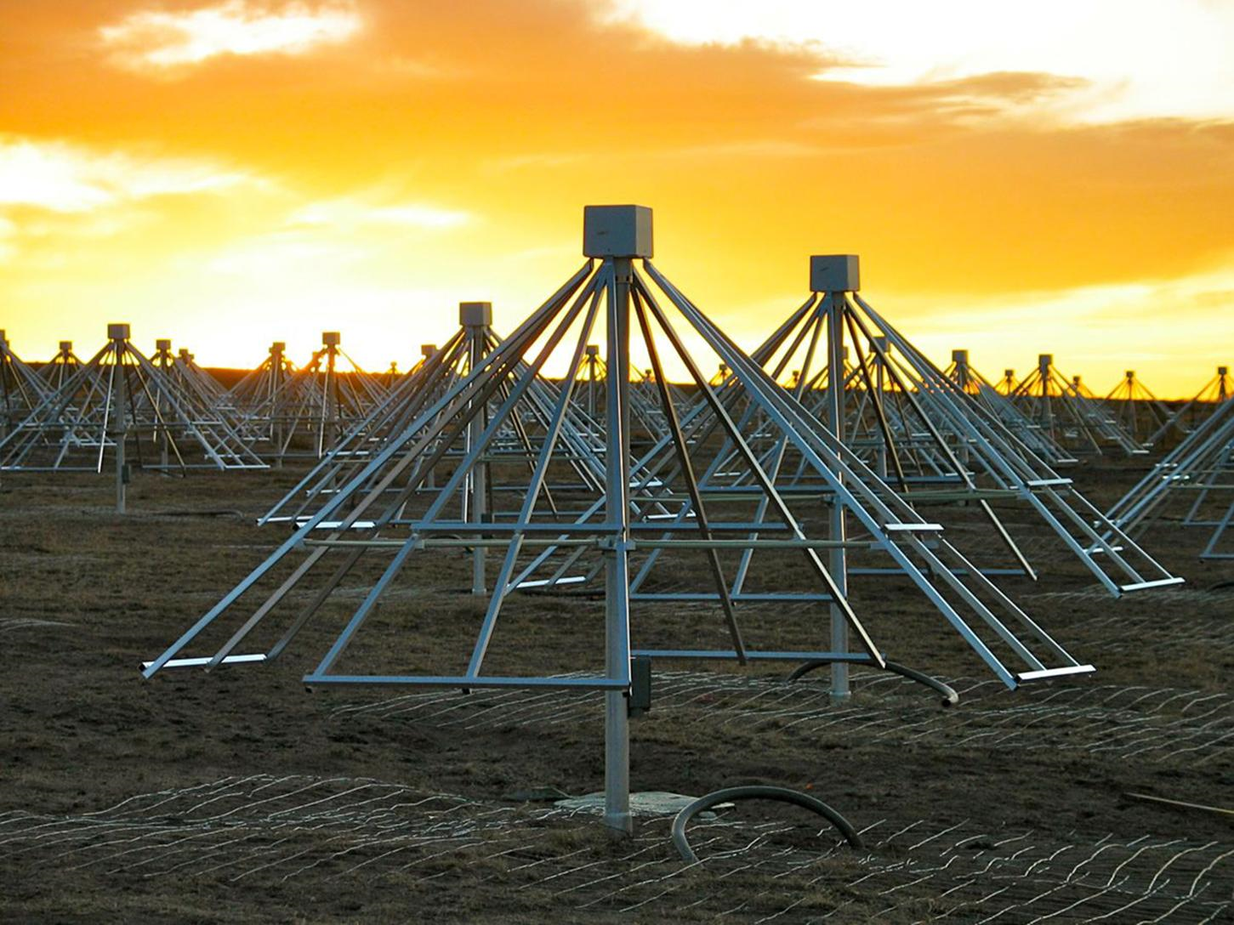


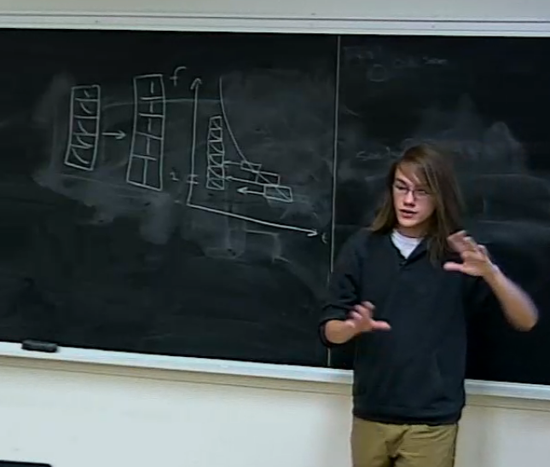
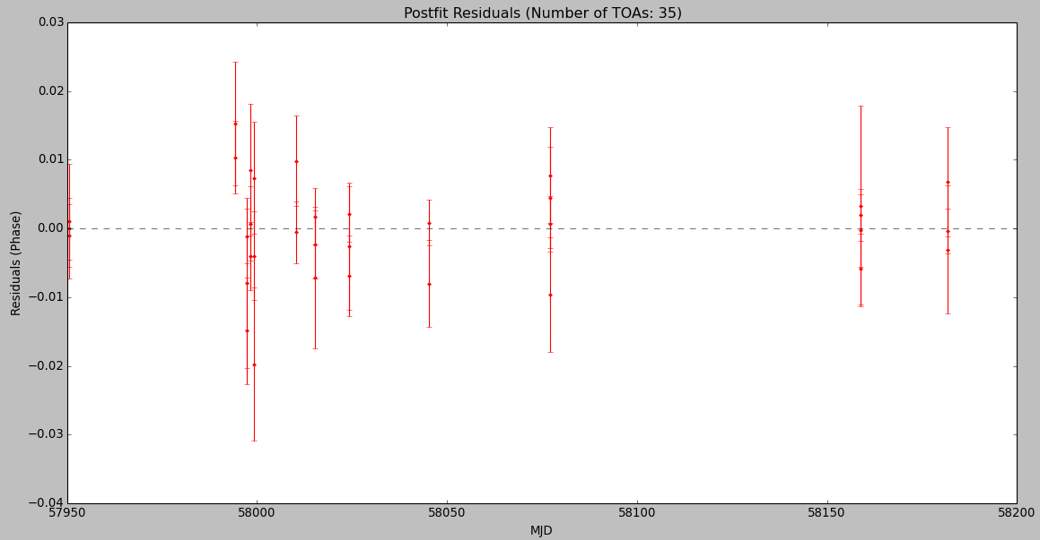
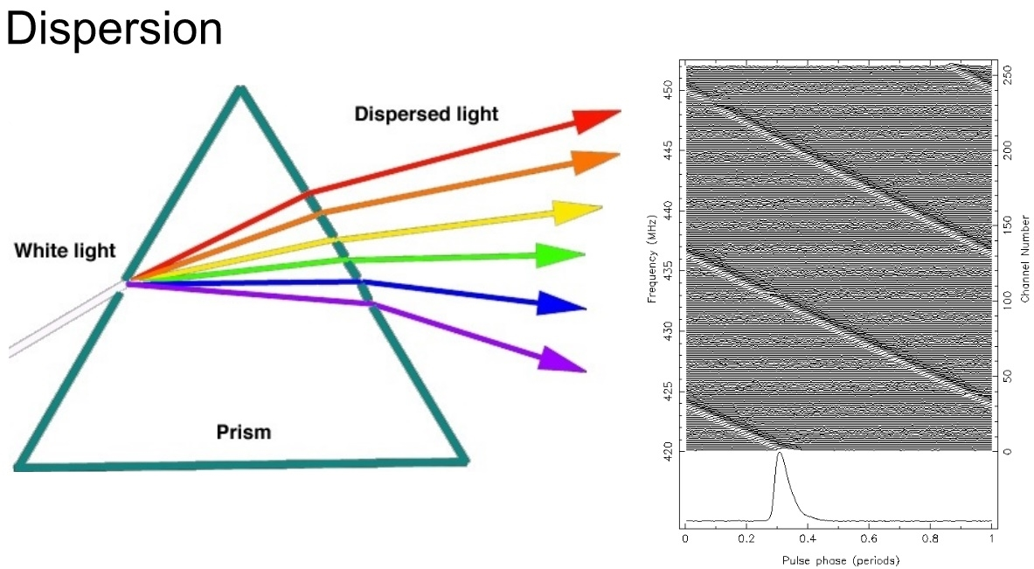
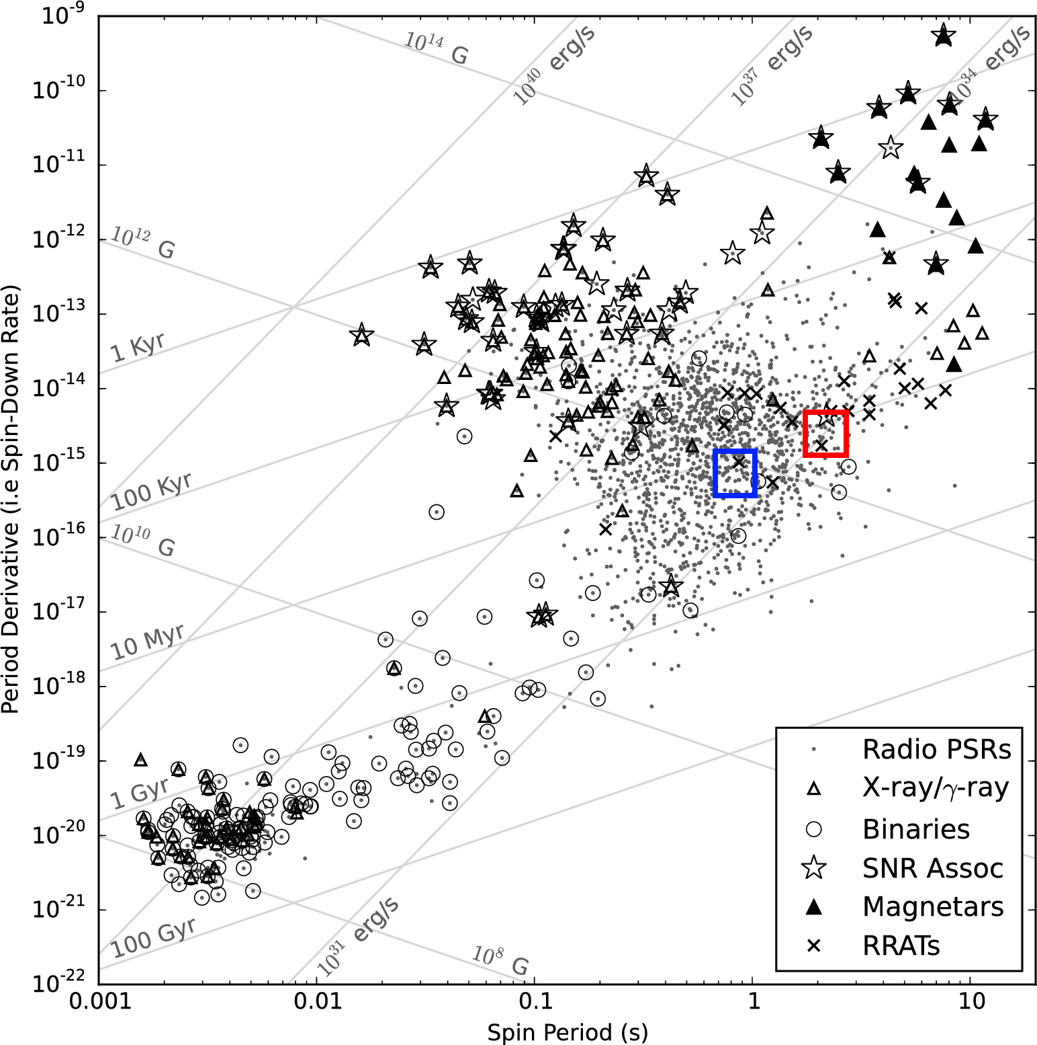
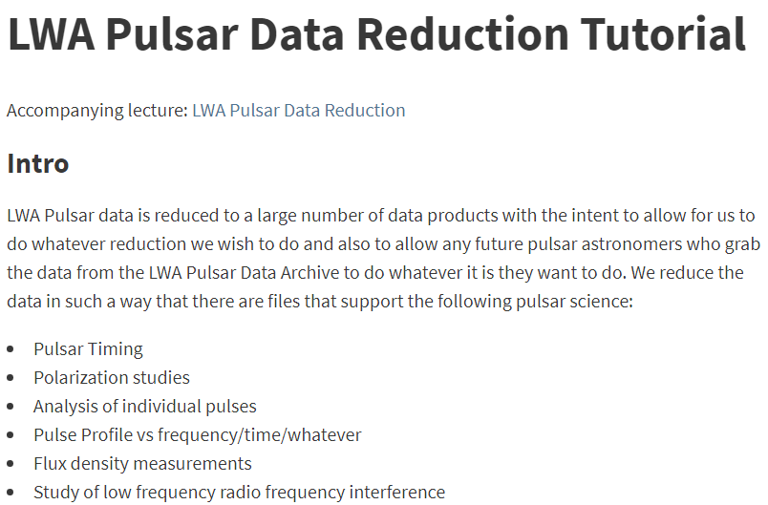
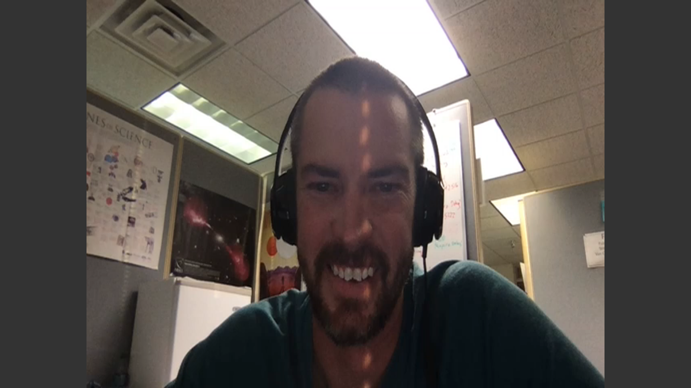
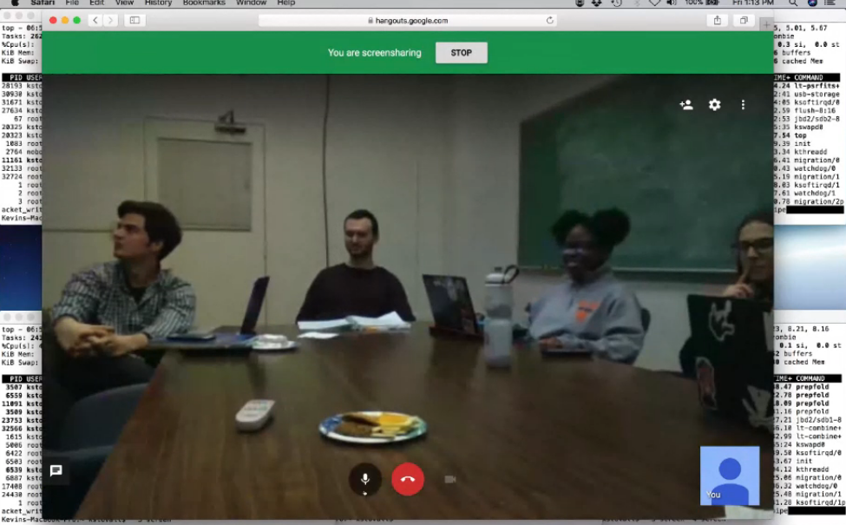
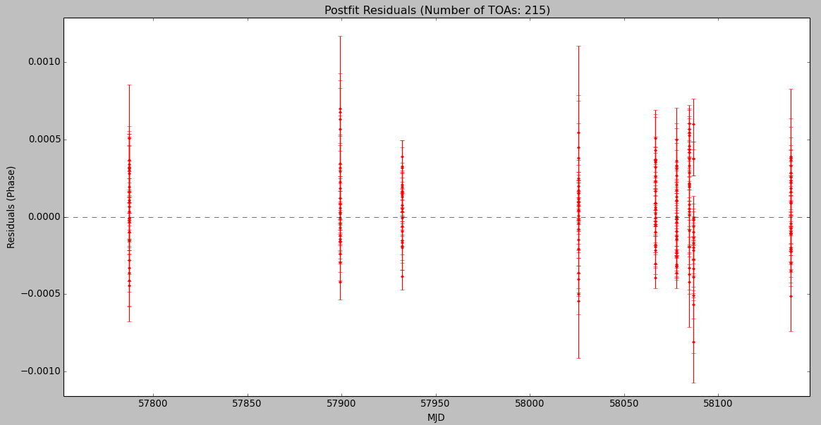





Pulsar Timing for Undergraduates: Research Meets Outreach
Steven Stetzler¹, Kevin Stovall², Nick Clifford¹, Robin Leichtnam¹, Levi Schult¹, Morgan Waddy¹, Shelby Laychak¹
1: University of Virginia, Charlottesville, VA
2: National Radio Astronomy Observatory, Socorro, NM
Web: stevenstetzler.com/psr-obs
Abstract
The Pulsar Observers at UVA, consisting of 16 undergraduate students, uses the Long Wavelength Array to observe and construct a timing solution for 10 pulsars over the course of a year. Each of the pulsars we observed has either not had a pulsar timing solution published before, or its timing solution was published longer than 30 years ago. Since many of our members have no prior research experience, we are able to use our group as a platform for outreach among the undergraduate community, providing students with valuable research experience while giving them the opportunity to perform non-trivial scientific activities.
Observations of Pulsars
We observed 10 pulsars using the Long Wavelength Array over the frequency range of 25 - 89 MHz. New observations and archival LWA data were used to construct the timing solution for these pulsars. A list of observed pulsars is contained in Table 1.
Unpublished Pulsars
Binary Pulsars
Retimed Pulsars
J0611+30
B0655+64
B1504-43
B1133+16
J1929+00
B0820+02
B0950+08
B0823+26
Group Structure
Our group works independently with long-distance guidance from our mentor Dr. Kevin Stovall. Students learn about pulsar timing through talks with radio astronomers, Kevin Stovall and Scott Ransom, and through instructional lectures by our student leader, Steven Stetzler. All work is documented on our group website.
J2227+30
B2016+28
B2020+28*
Table 1: The list of our target pulsars.
*B2020+28 is an extra pulsar in the beam of B0823+26.
Results
Preliminary timing solutions have been made for pulsars J2227+30 and B1133+16. Plots of their post-fit residuals and initial values for their solution parameters are shown in Table 2.
Video conferencing and in-person lectures provide introductory information on
Working with the command line
Processing observations from the LWA to
search for pulsars
Searching for a removing RFI in data
Modifying pulsar data to create pulse
profiles
Generating Time of Arrivals (TOAs) from
observations
Producing timing solutions
J2227+30
$F$
$\dot{F}$
$RAJ$ $DECJ$
$DM$
1.1871
-1.1667
22^{h}27^{m}42^{s} 30◦38’23’’
19.963
Figure 3: Post-fit residuals for J2227+30. Weighted RMS = 4200 $μs$
B1133+16
$F$
$\dot{F}$
$RAJ$ $DECJ$
$DM$
0.8418
-2.6366
11^{h}36^{m}03^{s} 15◦51’06’’
4.847
Figure 5: The location of J2227+30 (Blue) and B1133+16 (Red) in the $P−\dot{P}$ plane
Figure 2: Conference calls and in-person lectures provide students with introductory information on pulsars.
Figure 4: Post-fit residuals for B1133+16. Weighted RMS = 300 $μs$
Figure 1: Text based tutorials are also available online for later reference.
Expansion of the Group
Since our work is shared online and inherently instructional, anyone can join at any time from any distance. This structure in a research group allows for us to expand to other institutions. Alumni of this program can continue to lead this group at UVA or can create a new group at the graduate schools that they attend, piggybacking on what we have already built.
Acknowledgements
We thank Dr. Kevin Stovall for assisting us tremendously in the creation of this group and the production of these results. We would like to also acknowledge the Society of Physics Students (SPS) for providing us significant financial support, allowing us to present at the APS conference. We would also like to thank Gregory Taylor for supporting this project and providing observation time on the Long Wavelength Array. Background image courtesy of NASA.

